Slide 1


ESLSCA
COIN
REVOLUTIONIZING UNIVERSITY TRANSACTIONS WITH BLOCKCHAIN
YASSIN BEDIER, AHMED KHATTAB, AHMED HATEM, ISLAM AKRAM, IBRAHIM LABIB
1

Slide 2


ESLSCA
COIN
Overview
ESLSCA Coin is a digital currency built for ESLSCA University based on Ethereum Technology and ERC-20 token standard.
Features:
Solidity-based smart contract
Web user interface for sending/receiving/minting
Transactions history
MetaMask integration
2

Slide 3



ESLSCA
COIN
Problem
Statement
Traditional financial systems in educational institutions face several challenges:
No change is found sometimes when buying from cafeteria, etc.
Slow processing times for payments
Limited transparency in financial operations
Difficulty implementing reward systems for academic achievements
ESLSCA Coin addresses these challenges by providing a secure, transparent, and efficient digital currency for the university ecosystem.
3

Slide 4




ESLSCA
COIN
Technical
Architecture
Frontend Application (React, Ethers.js)
MetaMask Integration
Smart Contract (Solidity)
User Interface, Token Management and History
Wallet Connectivity, Transaction Signing
ERC-20 Implementation, Functions, Token Logic
4

Slide 5

ESLSCA
COIN
Smart Contract
Features
ERC-20 Standard Implementation
Token transfers
Balance queries
Allowances and approvals
Custom Events
TokensMinted (records new token creation)
TransferExecuted (detailed transfer records with timestamps)
Administrative Controls
Owner-only minting function
5

Slide 6


ESLSCA
COIN
Frontend
Application
MetaMask Integration
Token Management
Transaction History
Seamless connection and account detection
Network validation and switching
Balance display with proper decimal formatting
Send and receive functionality
Chronological list of all transactions
Transaction details with copy functionality
6

Slide 7
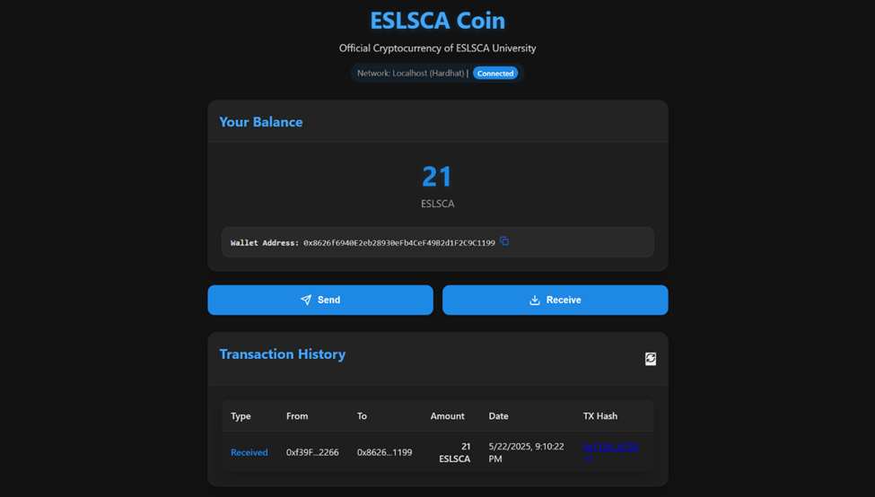
ESLSCA
UI Showcase
COIN
7

Slide 8
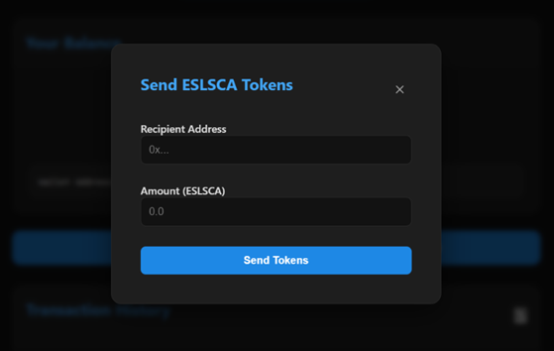
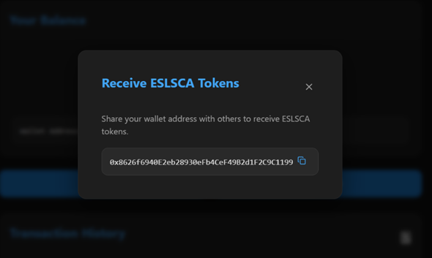
ESLSCA
UI Showcase
COIN
8

Slide 9

ESLSCA
COIN
Conclusion
ESLSCA Coin demonstrates a practical implementation of blockchain technology in an educational context. By providing a secure, transparent, and efficient digital currency, it offers enhanced capabilities for future innovation.
The project successfully fulfills its objectives of creating a functional ERC-20 token with custom features, developing a user-friendly interface, implementing secure administrative controls, and providing transparent transaction tracking.
9

Slide 10

ESLSCA
COIN
THANK
YOU
10

